Slide 1

Lecturer: Eng. Mahdi Obsiyeh
CCNP
Eelo University
Faculty of IT, TE, BIT
Borama, Somaliland

Slide 2
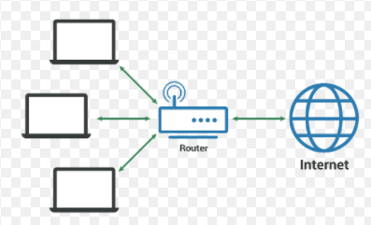
Design and Building Campus Network Chapter 1

Slide 3
INDEX
Campus Network Design
Hierarchical Network Design
Predictable Network Model
Access, Distribution and Core
LAN and VLAN
Benefit of LAN

Slide 4
What is a “campus” network anyway?
A campus network is an enterprise network (hundreds or thousands of users) where we have one or more LANs in one or multiple buildings. Everything is geographically close to each other so we typically use Ethernet and Wireless for connectivity.
Typically the company owns everything on the campus including hardware, computers and cabling, etc. To support this many users we require a lot of switchports which means a lot of switches.
We need a physical design to connect these switches to each other and also a good logical design to make it work.

Slide 5
Campus Network Design
This chapter presents a logical design process that you can use to build a new switched campus network or to modify and improve an existing network.
Networks can be designed in layers using a set of building blocks that can organize and update even a large, complex campus network.
These building blocks can then be placed using several campus design models to provide maximum efficiency, functionality, and scalability

Slide 6
Hierarchical Network Design
A campus network is an enterprise network consisting of many LANs in one or more buildings, all connected and all usually in the same geographic area. A company typically owns the entire campus network and the physical wiring. Campus networks commonly consist of wired Ethernet LANs and shared wireless LANs.
An understanding of traffic flow is a vital part of the campus network design. You might be able to leverage high-speed LAN technologies and “throw bandwidth” at a network to improve traffic movement.
The network traffic can then be effectively moved and managed, and you can balance the campus network to support future needs.

Slide 7
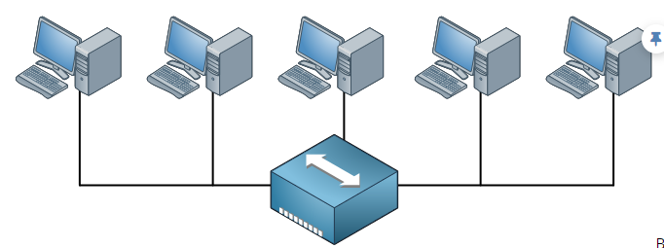
To support this many users we require a lot of switchports which means a lot of switches. We need a physical design to connect these switches to each other and also a good logical design to make it work.
Let’s take a look at some networks to see how they “grow” and some design issues that we will face. Let’s start with a simple example:
HUB

Slide 8
Old days we used to have Hubs so we had half-duplex networks. When one host would transmit something, the others had to wait..
Everything that is connected to the hub is a single collision domain. Also, whenever a host sends a broadcast everyone will receive it. There’s only one broadcast domain
In this example there are only 5 hosts so it’s no problem but when you have hundreds of hosts the collisions and broadcasts will have a serious impact on the available bandwidth.

Slide 9
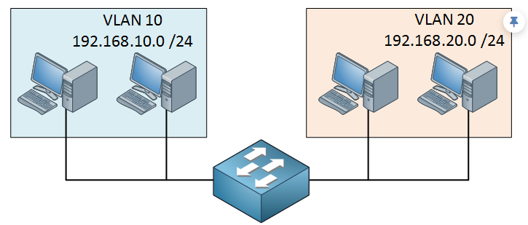
To reduce the size of the collision domain we started using bridges and then switches. The broadcast domains can be reduced by using VLANs. Here’s an example:
SWITCH

Slide 10
Now we have a single switch and some hosts that are in different VLANs. Each port on the switch is a collision domain and each VLAN is a separate broadcast domain. If we use a Multilayer switch, the VLANs will be able to communicate with each other.
Once this network grows we might not have enough switch ports anymore on a single switch. You could add a second switch and connect it to the first one but what if we add a third of fourth switch? How are we going to connect them to each other?

Slide 11
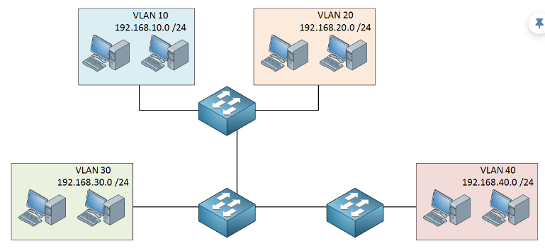
If you don’t think about your design beforehand, you might end up with something like this:

Slide 12
We need a network that is easy to maintain, offers high availability, scalability and is able to quickly respond to changes in the topology.
To achieve all of this, Cisco has a hierarchical approach to network design where we have multiple layers in the network. Here’s an example:

Slide 13
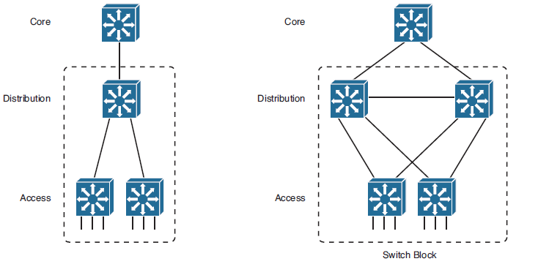
Figure 1-8
Figure 1-8 Improving Availability in the Distribution and Access Layers

Slide 14
Access Layer
The main function of the access layer is to connect all end devices like computers, laptops, access points, IP phones, printers, etc.
■ We require a lot of switchports to connect all these end devices.
■ Depending on our traffic flows, traffic from the access layer has to go towards the distribution layer so we might require multiple uplinks.
■ High availability
■ Ability to converge network services (that is, data, voice, video)
■ Security: The access layer is the “entry” of our network. You might want to protect DHCP, ARP and spanning-tree from malicious devices that are connected to the access layer.

Slide 15
Distribution Layer
The distribution layer connects the access and core layer together. Typically the distribution layer is where we use routing, this is where we terminate the VLANs from the access layer.
■ Combination of multiple access layer switches
■ High Layer 3 routing throughput for packet handling
■ Security and policy-based connectivity functions
■ Multiple redundant uplinks to the access and core layer
■ Few users connecting distribution layer

Slide 16
Core Layer
A campus network’s core layer provides connectivity between all distribution layer devices. The core, sometimes referred to as the backbone. This means the switches in the core layer should be able to handle all traffic from the distribution layer switches Core switches should have the following attributes:
■ If the core fails all connectivity between distribution layers will be impossible.
■ High bandwidth / throughput required.
■ High availability / redundancy required. Think about multiple links, redundant power supplies, and redundant supervisors (CPU).
■ No packet manipulation: We don’t configure access-lists or make changes to packets in the core.

Slide 17
Modular Network Design
Designing a new network that has a hierarchy with three layers is fairly straightforward. You can also migrate an existing network into a hierarchical design. The resulting network is organized, efficient, and predictable.
Consider the hierarchical network shown in the left portion of Figure 1-8 . Each layer of the network is connected to the adjacent layer by single links. If a link fails, a significant portion of the network will become isolated. In addition, the access layer switches are aggregated into a single distribution layer switch. If that switch fails, all the users will become isolated.

Slide 18
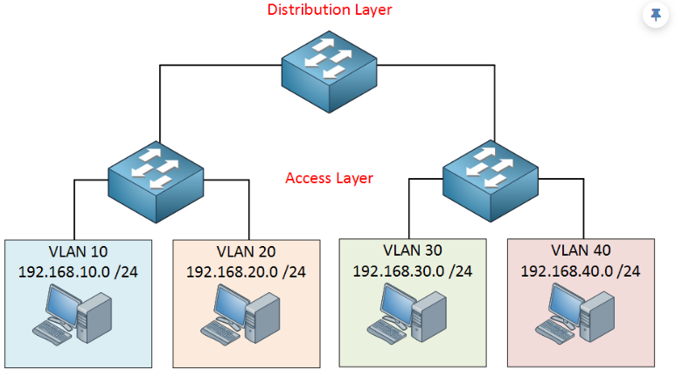

Slide 19
In this design we have an access layer and distribution layer. The access layer is close to the end users, these are switches that we use to connect computers, laptops, access points and more. The distribution layer is used to aggregate all the different access layer switches.
The advantage of this hierarchical network design is that it’s scalable. When the campus grows and we get more users, building and floors then we can add multiple distribution layers. When this happens, we’ll add another layer:

Slide 20
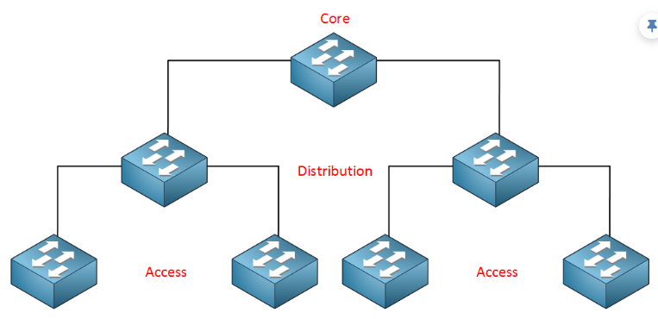
The core layer aggregates all the different distribution layer switches.

Slide 21
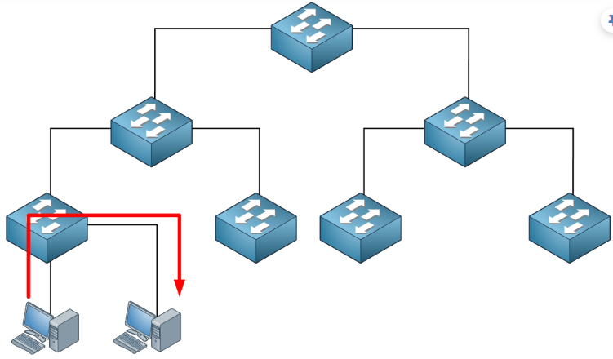
This design also makes our traffic paths predictable and easy to visualize. Basically there are three different traffic flows:
All traffic starts at the access layer and if needed it will move up the distribution and core layer. In this example the traffic is local; it doesn’t leave the access layer switch. This could be traffic between two hosts within the same VLAN

Slide 22
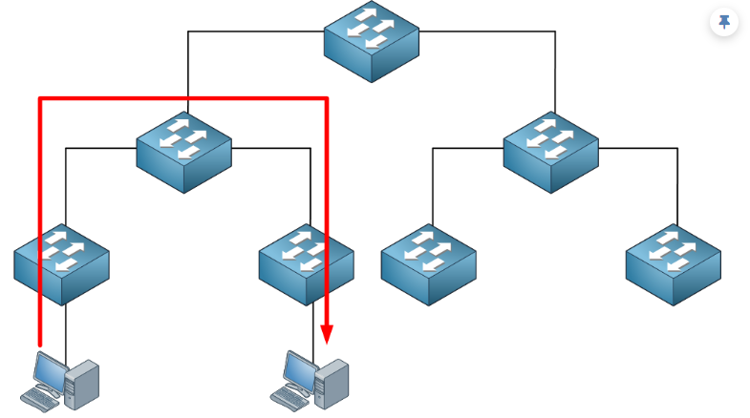
Here’s another example:
Traffic between hosts that are on different access layer switches has to cross the distribution layer switch.

Slide 23
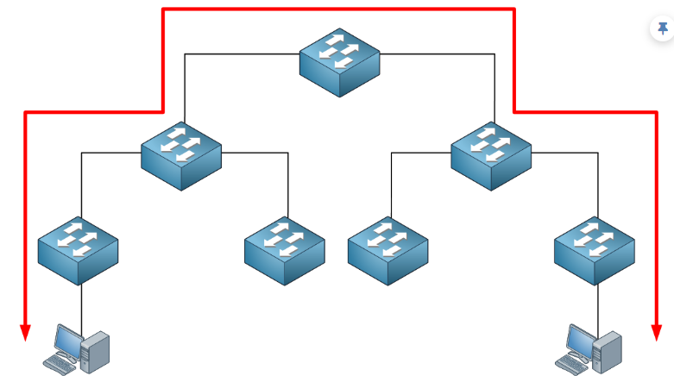
Finally, sometimes we have to cross the core layer:

Slide 24
Layer 2 Network Design Guidelines
Always connect hierarchically
If there are multiple switches in a building, use an aggregation switch Locate the aggregation switch close to the building entry point (e.g. fiber panel) Locate edge switches close to users (e.g. one per floor) Max length for Cat5 is 100 meters

Slide 25
Building Network

Slide 26
Minimize Path Between Elements
✗
✔

Slide 27
Build Incrementally
Start small
Fiber link to distribution
Switch
Hosts

Slide 28
Build Incrementally
As you have demand and money, grow like this:
Aggreg.
Switch
Hosts

Slide 29
Build Incrementally
And keep growing within the same hierarchy:
Aggreg.
Switch
Switch
Hosts

Slide 30
Build Incrementally
At this point, you can also add a redundant aggregation switch
Aggreg.
Aggreg.
Switch
Switch
Hosts

Slide 31
Do not daisy-chain
Resist the temptation of doing this:
✗

Slide 32
Connect buildings hierarchically
✔

Slide 33
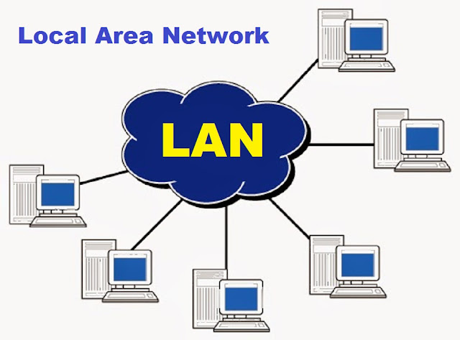
A local area network (LAN)
A local area network (LAN) is a collection of devices connected together in one physical location, such as a building, office, or home. A LAN can be small or large, ranging from a home network with one user to an enterprise network with thousands of users and devices in an office or school.

Slide 34
What are the benefits of a LAN?
The advantages of a LAN are the same as those for any group of devices networked together. The devices can use a single Internet connection, share files with one another, print to shared printers, and be accessed and even controlled by one another.
Easy Sharing
Easy to setup
Security
management
Communication
Flexibility

Slide 35
END

